Slide 1

MINI PROJECT
SMART CAP FOR BLIND PERSON
GLA UNIVERSITY ,MATHURA

Slide 2
OBJECTIVE
According to the world health organization, 2.2 billion people globally have a vision impairment or blindness. Blindness can be two types: some are fully blind and some people are partially blind. A fully blind person needs a person who can help to provide the right direction and tell them about the object that comes in front of him/her.
This is a basic problem faced by a blind person. As per today's time, IOT(INTERNET OF THINGS ) technology helps to solve such kinds of problems.
So, we made a Smart Cap which consists of a camera, ultrasonic sensors, microcontroller, speaker, GPS, etc. This cap helps blind people to know which object comes in front of him/them and the speaker tells how far an object is. By this a person blind person moves independently on the road.This cap act like a supportive person which always there for him/her.

Slide 3
COMPONENTS REQUIRED
1.Raspberry pi-3
2.Ultrasonic Sensor
3.Pi-Camera
4.Cap
5.Jumper wires
6.GPS module

Slide 4
DESCRIPTION OF SENSORS

Slide 5
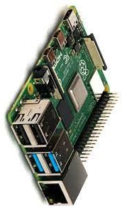
Raspberry pi -3
It is a microcontroller.
Memory size 1gb LPDDR2 SDRAM
It support python language and computer vision
little bit possible.
It has 4 USB PORT.
It has 1 audio jack 1 ethernet port 40 pins.

Slide 6
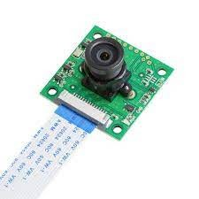
Pi-camera
It support all version of raspberry pi
It offer wider field of view 5 megapixel OV5647
Best resolution :1080p

Slide 7
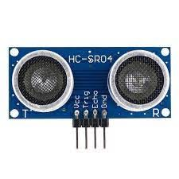
Ultrasonic Sensor
This device measure the distance.
It emit ultrasonic sound wave.
It has two component the transmitter and the receiver.
It covers the range 400 cm.

Slide 8
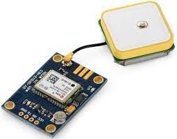
GPS Module
It stands for global positioning system.
It utilize data from satellites to locate specific point.
This module give latitude and longitude value.

Slide 9
CIRCUIT DIAGRAM

Slide 10
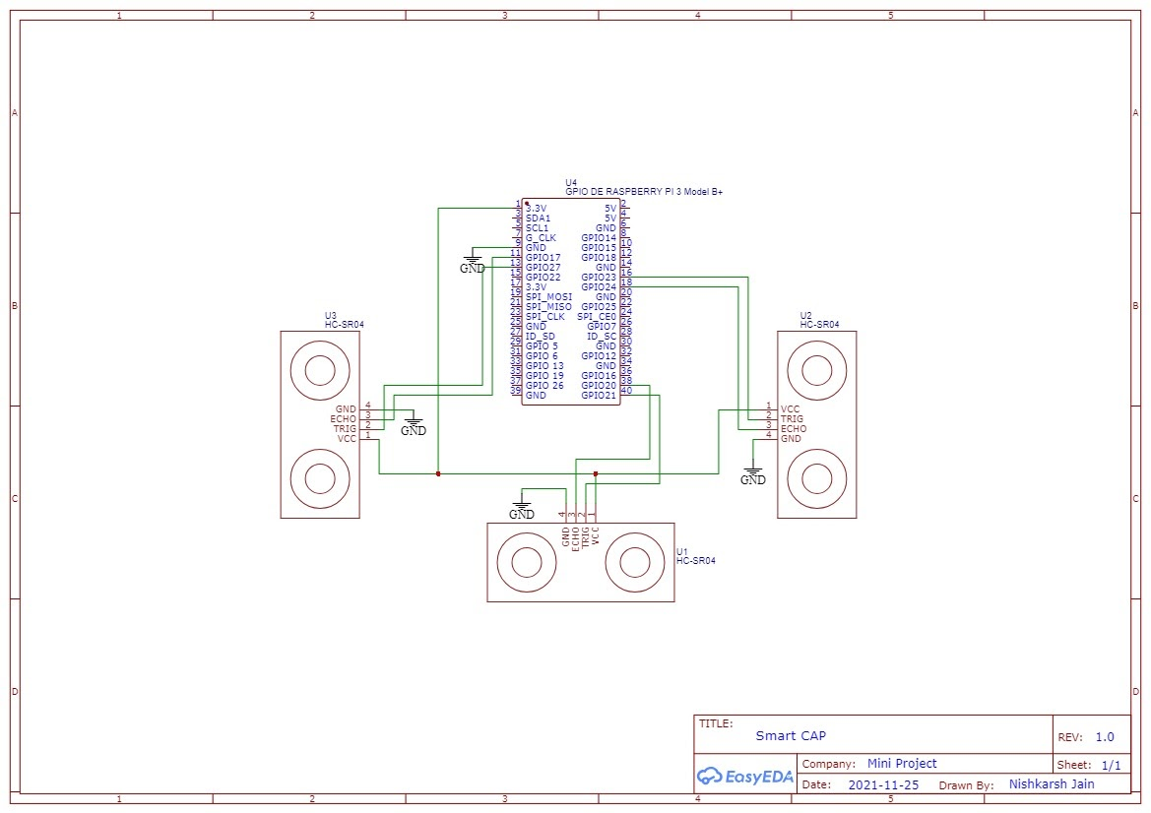

Slide 11
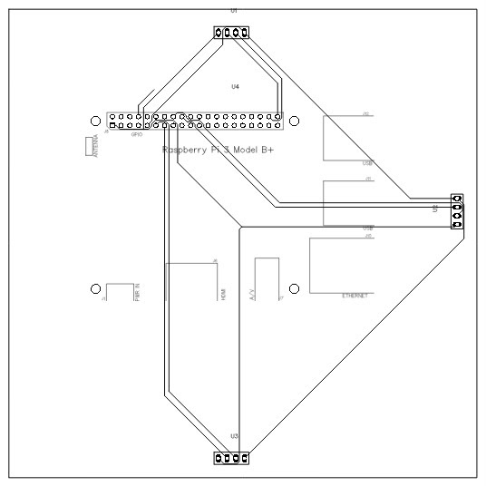

Slide 12
FLOW DIAGRAM

Slide 13
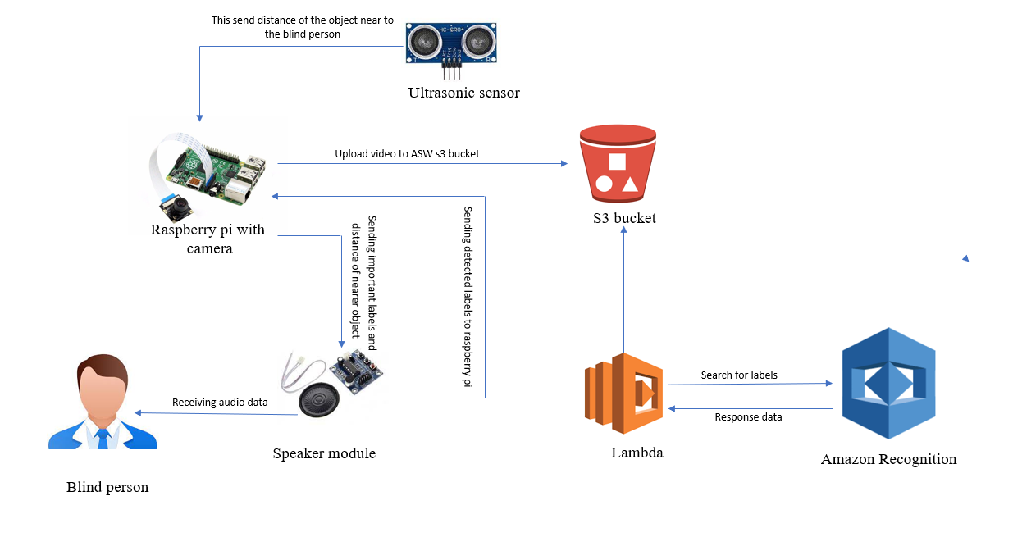

Slide 14
Prototype

Slide 15
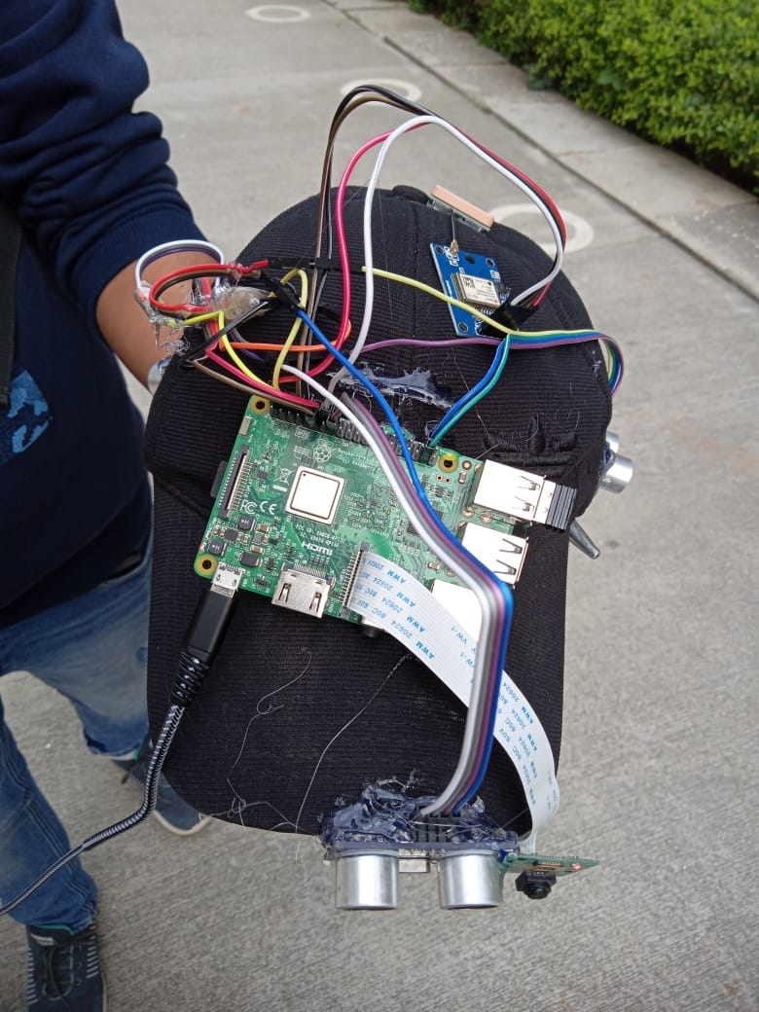

Slide 16
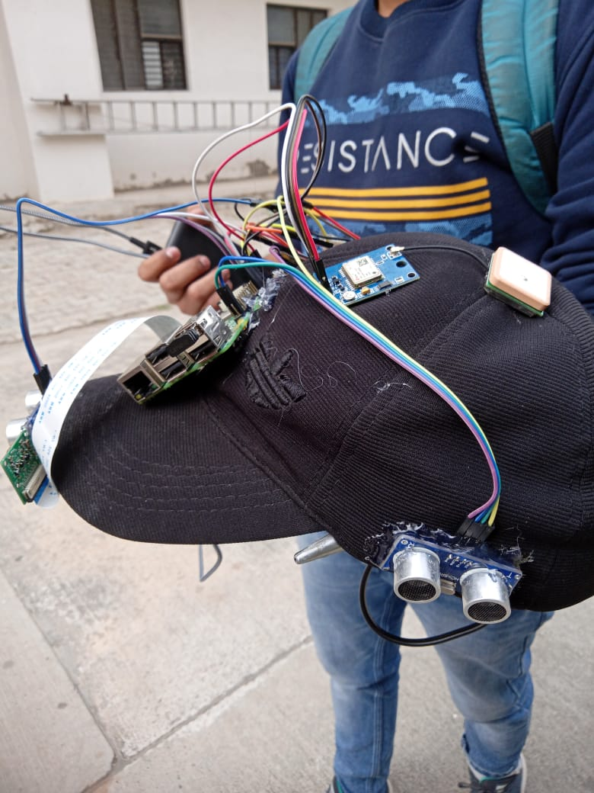

Slide 17
THANK YOU

